Slide 1
Psychological Inoculation Improves Resilience Against Misinformation on Social Media
- Jon Roozenbeek, Sander vander Linden, Beth Goldberg, Steve Rathje, Stephan Lewandowsky
Notes:
Hello everyone thanks for being here today today we're going to discuss about the article psychological inoculation improves resilience against misinformation on social media now if you're anything like me the first thing you would do after reading the title of this article is look up the dictionary meaning of inoculation

Slide 2
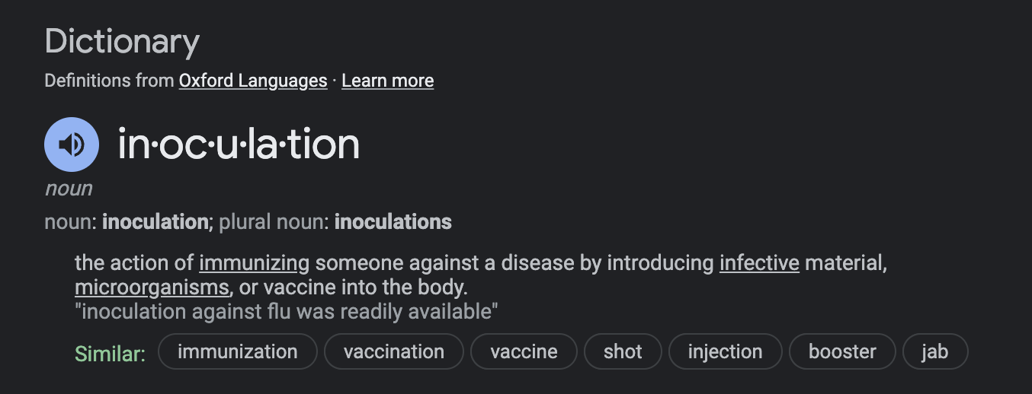
Dictionary Meaning
Notes:
Which is exactly what I did so inoculation means the action of immunizing someone against a disease by introducing ineffective material or a vaccine into the body basically the covid-19 vaccine right

Slide 3
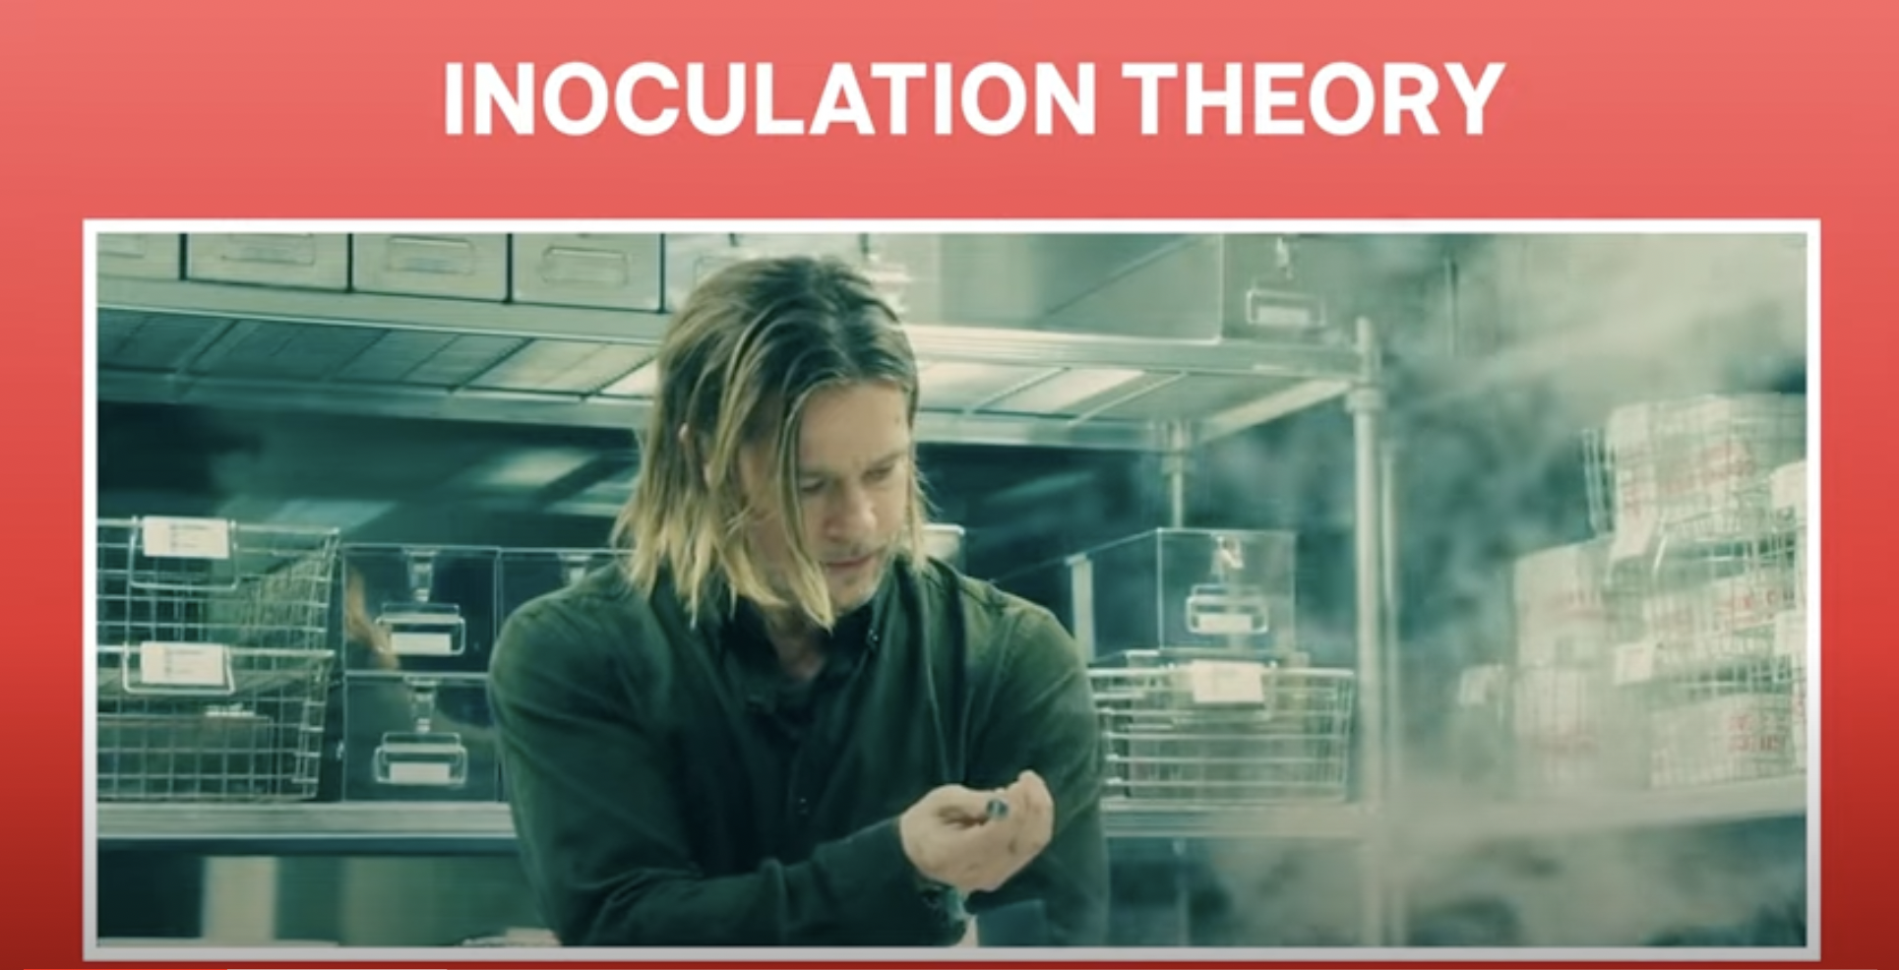
Movie Reference
Reference: YouTube
Notes:
But if you need a movie reference I found this one Called World War Z. Now, misinformation is like zombies, we see the same arguments and fallacies happening over and over again they just won't die in the movie brad pitt is trying to find a cure to the zombie virus in the end there is no cure but he discovers a way to stop the zombie virus from spreading by inoculating himself he's no longer a threat from the zombies. That's pretty much what's happening in this article in this paper as well but instead of immunizing our body we are trying to immunize our minds from misinformation and hence the term psychological inoculation

Slide 4
Still unsure what it means?
Notes:
If you're still lunch or what it means I have like some simplified definitions as well

Slide 5
Simplified Definitions
“Inoculation theory follows a medical immunization analogy and posits that it is possible to build psychological resistance against unwanted persuasion attempts, much like medical inoculations build physiological resistance against pathogens”
- Jon Roozenbeek, et al.
“Psychological inoculation works by helping people build “mental antibodies” by briefly exposing them to a weakened persuasive message and thoroughly refuting it”
- Medium
“Inoculation theory, in short, is to persuade someone not to be persuaded by another”
- Xinbo Lu
Notes:
The first definition is from the paper itself I'm pretty sure you guys must have read it the second one is from medium an article from medium that I found it says that psychological inoculation works by helping people build mental antibodies by briefly exposing them to weekend persuasive message and thoroughly refuting it it's pretty much itself explanatory and oh my favorite one and the previous definition that I found was by Schindler and that is inoculation theory in short is to persuade someone to not be persuaded by another it's crisp, it’s precise, I love it I'm going to use it all the time

Slide 6
What are some Psychological Inoculation tricks you’ve observed around you?
Notes:
Okay so now that we know the basic concept of Psychological inoculation I would like to know what are the what are some tricks that you observed in social media that involved psychological inoculation or around you

Slide 7


My Observation..
Source: Marca
Source: Dall.E
Notes:
Okay so this is one thing that kind of devastated me as a kid this is Iron Man and this was my imagination when I washed and I remember you I genuinely thought that there exists suits like that they're exist technology like that I was a kid what did I know but I did believe that

Slide 8
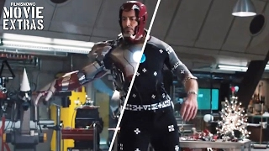
My Observation..
Notes:
Until someone showed me this with you which explains what at least gives a brief explanation of all the CGI effects that was used in Iron Man and it was all computers and it was not actually or suit the coolest suit does not exist anymore for me But the idea that I'm trying to purchase there was definitely a time when people believed computer generated information or was in fact true like photoshopped images like how a generated images are you not projected in front of people and they believe that it's true they believe it to be a source of information

Slide 9

My Observation..
Source: Marca
Source: Dall.E
Notes:
Now that I know that all of that is special effects this is my reaction now well obviously I'm still excited it's still Iron Man it's still Robert Downey Jr of course I'm excited but yeah I don't imagine my self in a suit anymore

Slide 10
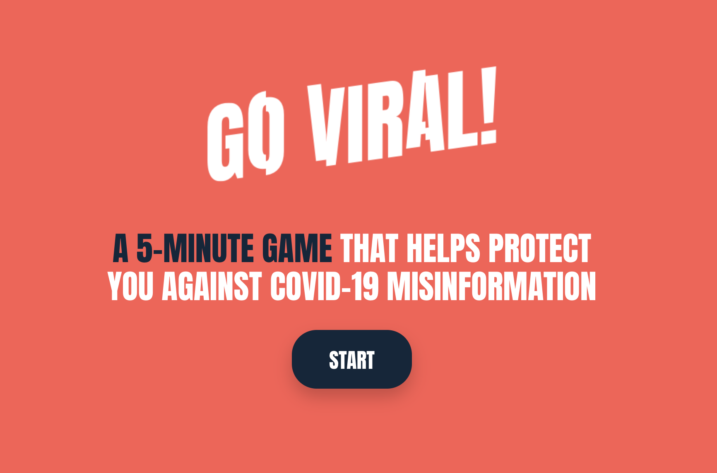
My Observation..
“Although it is not possible to inoculate everyone against misinformation on a permanent basis, if enough people have gained a sufficient level of psychological immunity to misinformation, fake news won’t have a chance to spread as far and as wide as it does currently.”
The Conversation
Notes:
Also this is one other interesting game that I came across but just called go viral it's well it's a fun wayTo inoculate the players the users against the misinformation about covid what you do in this game is a basically you become the manipulator and you know what would you do if you had too manipulate people it kind of uses that reverse psychology thing this is one quote that I found in the art girl from which I ended up finding this game as well it's not possible to inoculate everybody against misinformation it's yeah that's pretty much obvious but if enough people have came to sufficient you know level of immunity to misinformation fake news you know wouldn't spread as far as it does currently which is still a win

Slide 11

The Present Research (AI version)
Source: Steve AI
Notes:
Okay moving on I'd like to Talk about the present research that the paper had now I took a Little Help From a little friend the AI and tried to convert the entire paragraph into a video and I would like for you to sleep it's a short video Less Than 3 minutes so yeah let's have a look

Slide 12
“so they do think that these strategies might not work in political settings/sensitive settings. But I would argue that the most "dangerous" misinformation topics are entrenched in politics, personal biases etc. It would be interesting to design a study that takes into account these biases.”
- Saloni
Notes:
Okay so one thing that we saw that was highlighted in our beautiful AI video was also the fact that they did not include the misinformation topics related to politics or personal disease I like the fact that's a lonely highlighted it that it would be interesting designer study that takes into account these biases because yeah well those are the topics that have the most amount of Miss information on the internet but yeah I'd like to know me do you have like an idea in mind

Slide 13
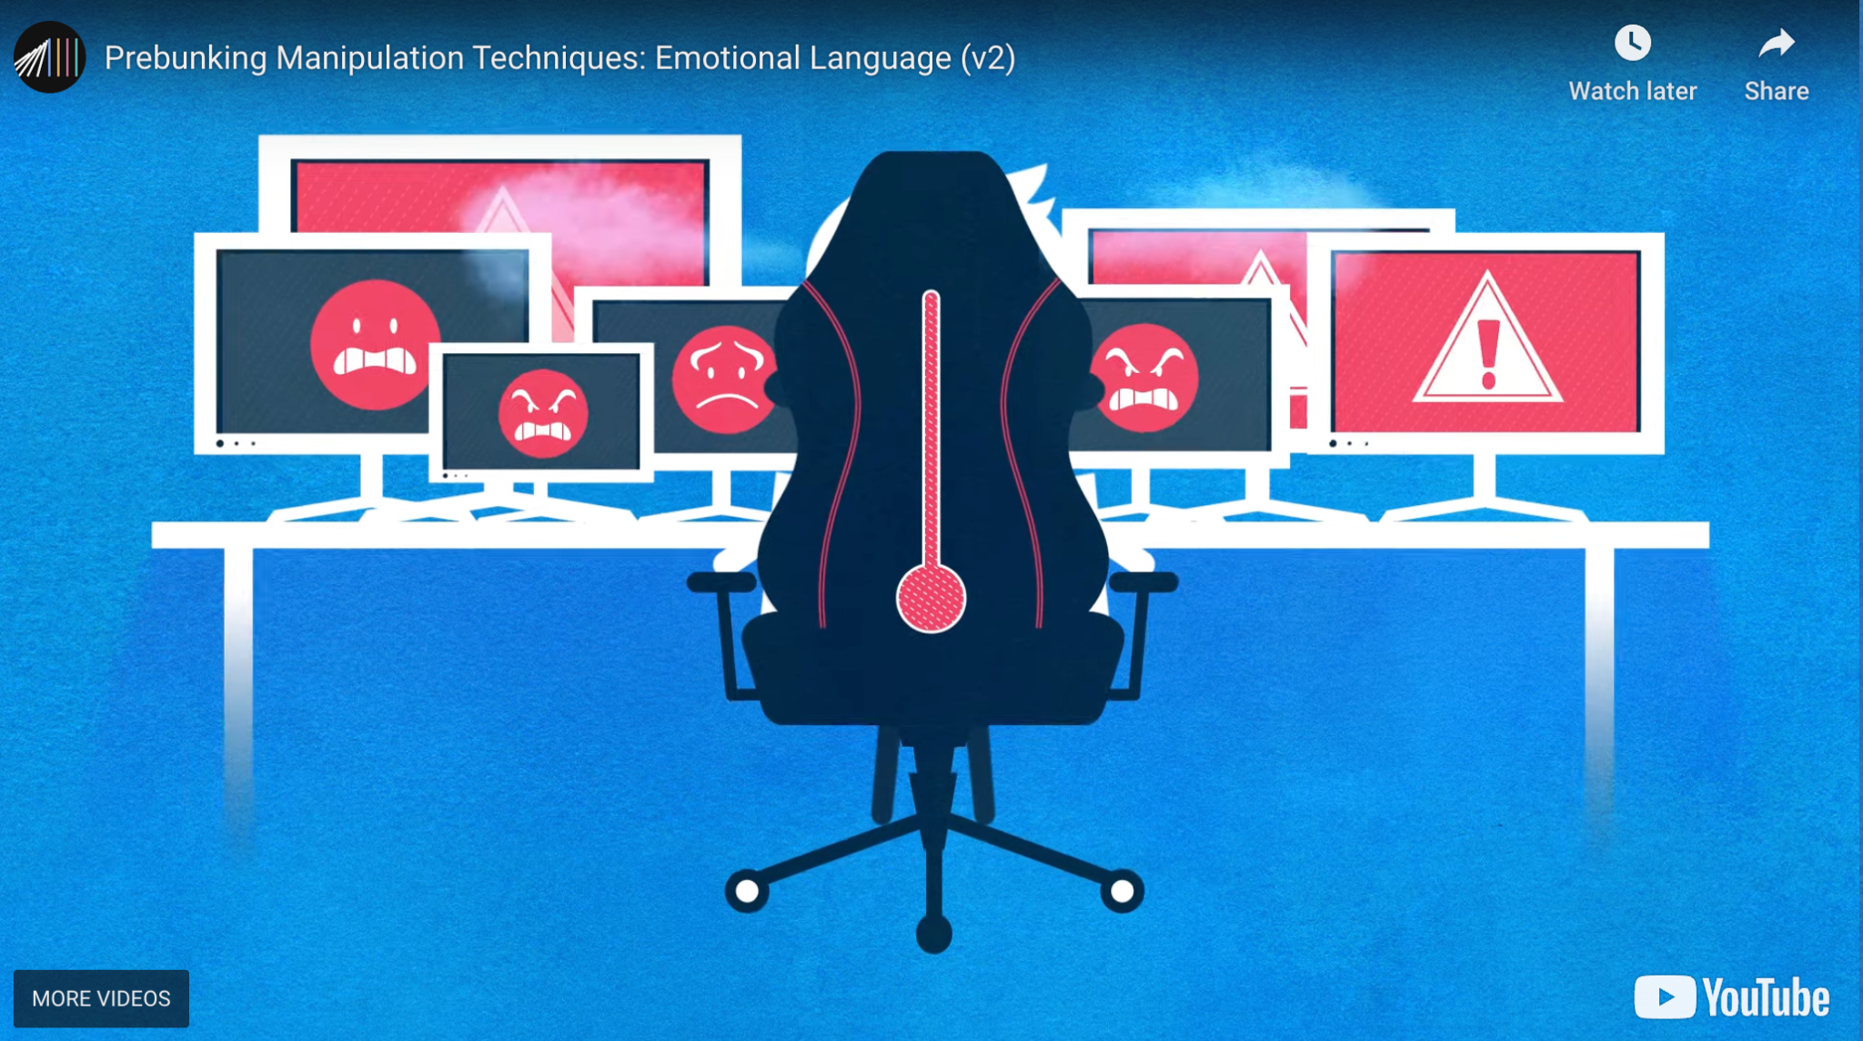
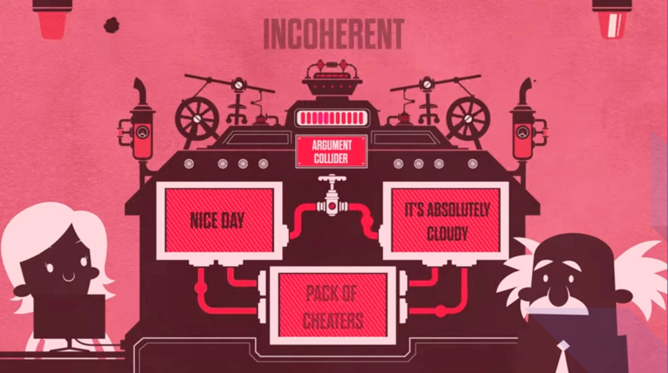
The Fab Five Manipulation Tactics
Emotional Language
Incoherence
Notes:
The other interesting thing that we learned through this paper was The Fabulous Five manipulation tactics. To give you a quick recap I just want to show you there is emotional language in which you you know use strong words like disgusting or is extremely sad Etc incoherence is when you kind of contradict two things absolutely like on one handiest thing oh it's such a nice day and the other is absolutely cloudy I loved how these videos had a Family Guy reference

Slide 14
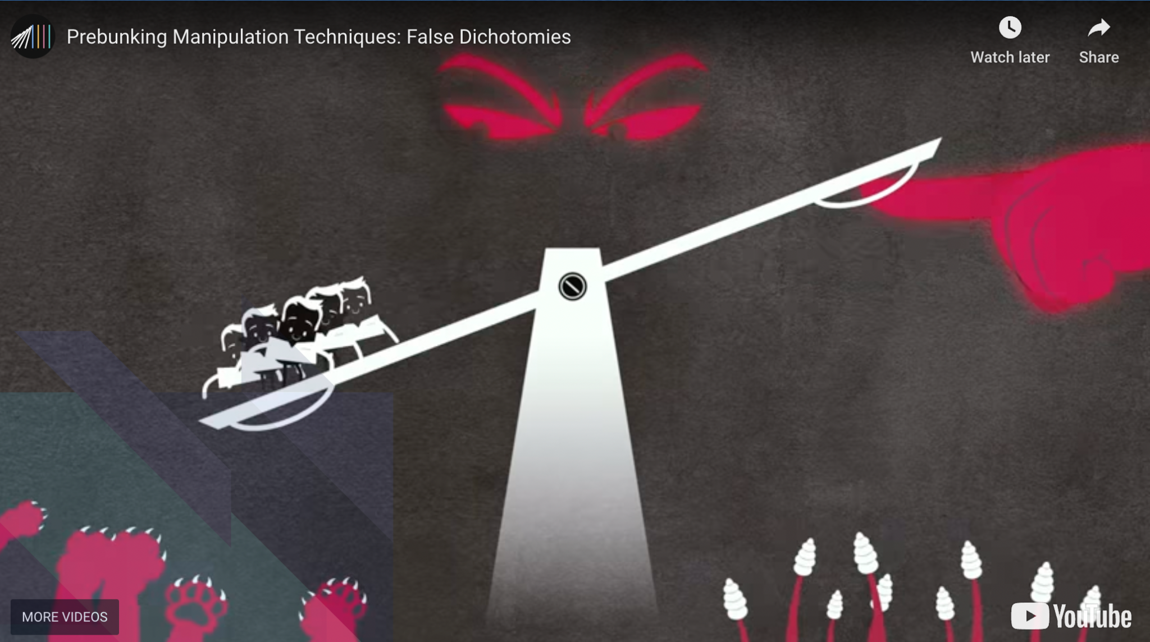
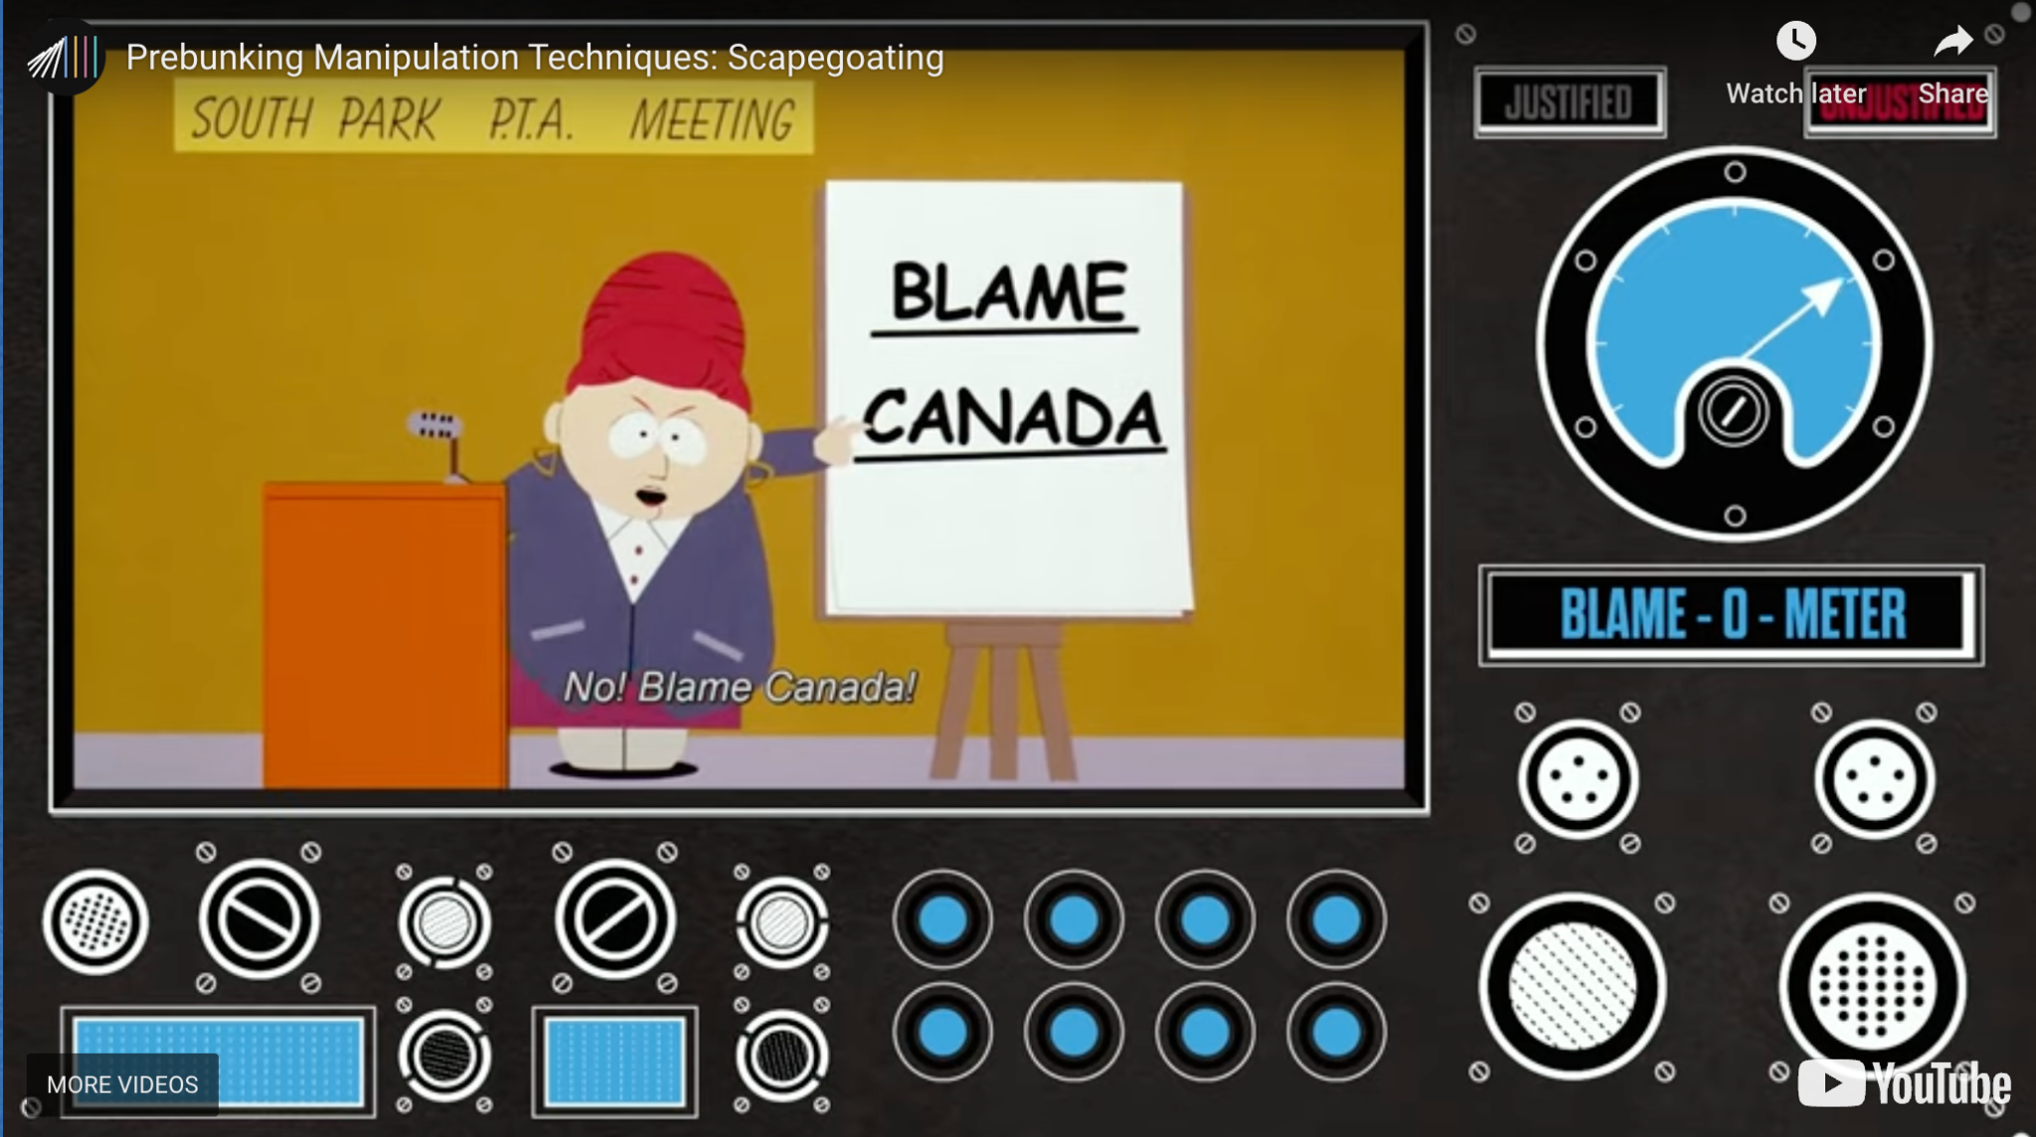
The Fab Five manipulation Tactics
False Dichotomies
Scapegoating
Notes:
On the next one is false dichotomies or false dilemmas in which while you are shown you know you are just given two options when in reality you have many more than that like for example somebody is telling you you either be my friend or I'll kill you stuff like that the next one was Cape coding well you find someone to blame everything on the roads are not clean of course it's the government's fault it has nothing to do with people being lazy and dirty and just throwing everything everywhere obviously it has nothing to do with that it's all the government

Slide 15
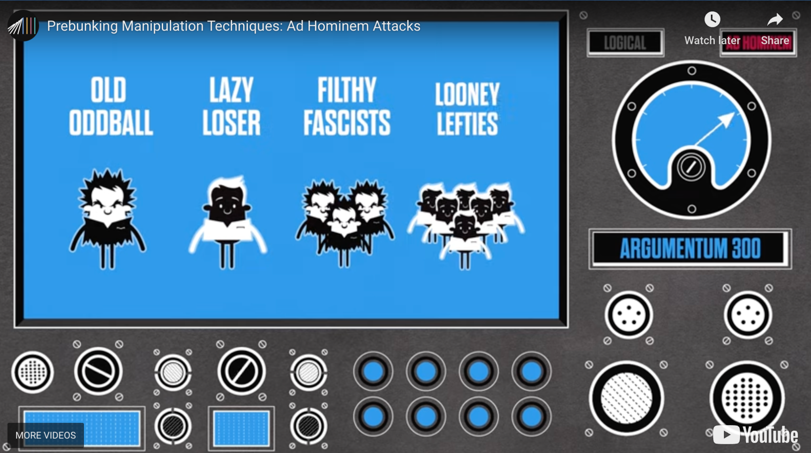
The Fab Five manipulation Tactics
Ad Hominem Attacks
Notes:
The last one of the Lord was ad hominem attacks where you basically attack in a certain set of individuals based on their maybe race, their looks, etc

Slide 16
How would you categorise your observed trick?
Notes:
I'm curious about what do you think which category of these five does your previously picked you know observe trick license

Slide 17
My Observation..
Emotional Language
Notes:
A better comparison would be to compare the covides to something like the flu you know they're both like diseases the some similarity the some similar background the similar audience and it would rather make sense than to compare it with some War numbers you know

Slide 18
Fake or Real?
Identifying Actual News articles from the fake ones
Notes:
Okay so now that we have so much knowledge about what is fake and what is real I thought we can play really good game that I found out on the internet

Slide 19
Game Time!
Notes:
Okay so now there is a game!

Slide 20
Instructions
Find a seemingly impossible piece of information (for e.g. The Earth is Flat!)
Find articles, papers, publications, basically any resource to prove that your chosen piece of information is in fact the truth!
Switch your documents with the person nearest to you
Now come up with logical explanations for why your friend’s resources and claim are nothing but nonsense (don’t be rude though!)
Notes:
The instructions are pretty simple you have to find a seemingly impossible piece of information like the Earth is flat and you need to come up with articles papers Publications like any resource basically to prove that your chosen piece of information is in fact the truth and there is all sorts of resources available like facts and everything the next thing that you do we're going to do this for say 7 minutes and then we'll switch the document with the person who is nearest to you and now the switched person has to come up with logical explanations preferably using the terms that we've learned in the paper and you know prove that the claim that the other person has made is nonsense and yeah try not to be rude though

Slide 21
Responses

Slide 22
The Research Method
1. Researchers tested interventions on YouTube, known for conspiracy and false content consumption.
2. Two effective videos from previous studies were used as YouTube ad campaigns.
3. Around 967,000 YouTube users watched one of the videos.
4. Within 24 hours, 30% of the treated group received a test question about manipulation techniques in a headline.
5. Performance of the treated group was compared to a control group that answered a test question but didn't receive the intervention.
6. Treatment group outperformed the control group in identifying manipulation techniques in headlines.
Notes:
Okay we seem to have a pretty good knowledge of how the researchers are conducted but the YouTube research specifically that was mentioned in the paper that was the most interesting for me the the whole method I mean the researchers like tested interventions on YouTube you know which is like known for conspiracy and conspiracy and false consumption all of those things and the fact that they chose almost a million YouTube users and they were able to you know get the same sort of results that they have been getting in the other studies that they did

Slide 23
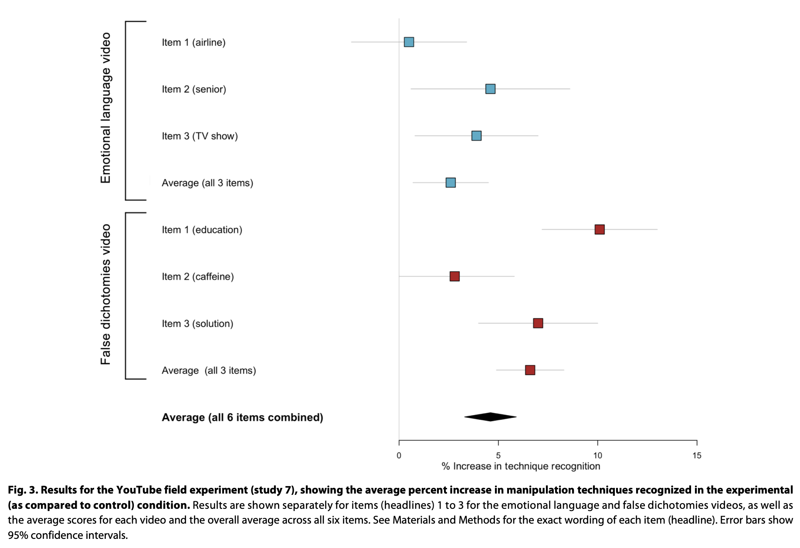
Notes:
And though yeah we did find that in a bunch of different categories the people's resilience to misinformation had been increased because they were you know thought about or soon about the kind of manipulation that they can incur in the future you know yeah

Slide 24
Psychological Inoculation campaigns on social media are effective in detecting misinformation.
Conclusion
Notes:
And yeah there was a conclusion that came up in the paper that psychological inoculation campaigns on social media are effective in detecting the misinformation great but I I just wonder

Slide 25
What do you think are the potential challenges and ethical considerations associated with implementing psychological inoculation in social contexts?
Notes:
What do you think are the potential challenges and ethical considerations associated with you know implementing these psychological inoculation

Slide 26
My thoughts
Unintended consequences
Consent and transparency
Privacy concerns

Slide 27
Any other interesting thing that you noticed in the paper and we missed discussing?

Slide 28
Thank You!

